Slide 1
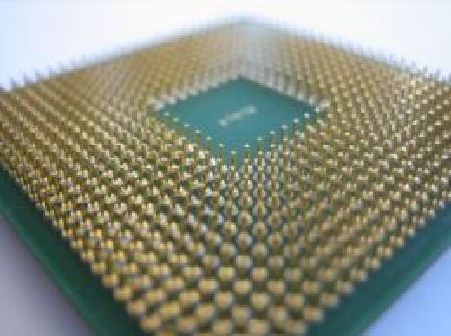
PARALLEL C
PRESENTATION
Group 18
Ankith Sudheer Karat
Arun Baby

Slide 2
INTRODUCTION
The GCC compiler creates a binary file, capable of running on a single processor.
Writing parallel code for a multi-processor architecture involves-
learning a complicated language
understanding intricate low level details of your system!
Parallel C parallelizes your code at the click of a button!

Slide 3
EXISTING SYSTEM
Currently the GCC compiler can produce a file capable of running only on a single processor.
Thus in a multi processor architecture, following are the drawbacks -
Wastage of Processing Power.
Wastage of resources.
High Processing time.
Overload on a single processor.
System specs don’t alter performance!

Slide 4
PROPOSED SYSTEM
Parallel C shares the load between processors using a Multi-threaded and shared memory model!
A serial C code is taken as input.
Hotspots and Bottlenecks are identified (Estimation Module)
Critical sections, nature of variables etc are analyzed (Analyzing Module)
Appropriate constructs are added to parallelize the code (Splitting Module)
A parallel version of the given input program is obtained!

Slide 5
ADVANTAGES OF PROPOSED SYSTEM
No processor is left idle.
Increased efficiency since optimal job allocation algorithms followed.
Less resource wastage and quick execution time.
Identification of Hotspots and Bottlenecks in the program for further efficiency improvement by programmer.

Slide 6
OpenMP : Open Multi-Processing
This project relies heavily on the constructs of opencv library
OpenMP is an Application Program Interface (API), jointly defined by a group of major computer hardware and software vendors.
OpenMP provides a portable, scalable model for developers of shared memory parallel applications.
It consists of a set of compiler directives, library routines, and environment variables that influence run-time behavior.

Slide 7
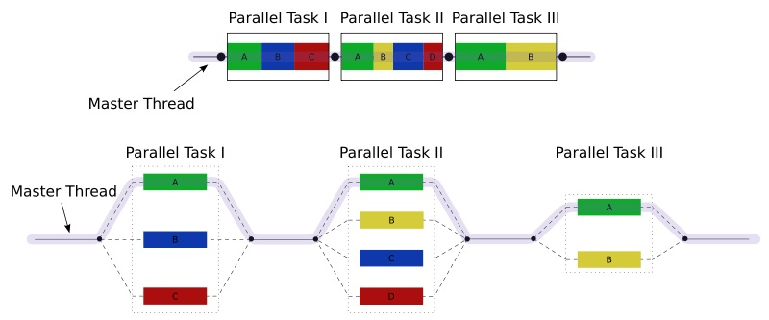
OpenMP : Open Multi-Processing
An illustration of multithreading where the master thread forks off a number of threads which execute blocks of code in parallel.

Slide 8
PROJECT MODULES
Estimation Module
Analyzing Module
Splitting Module

Slide 9
Module 1
ESTIMATION MODULE

Slide 10
ESTIMATION MODULE
This module focuses on identifying Hotspots in the code.
These are regions where maximum computation occurs.
Identifies regions that can be parallelized.
The blocks of code where maximum computations occur are –
Loops
Recursions

Slide 11
Module 2
ANALYZING MODULE

Slide 12
ANALYZING MODULE
Each identified block by the previous module is analyzed for the following
CRITICAL SECTIONS and other bottlenecks.
Variables PRIVATE to every thread.
Variables to be SHARED among the threads.

Slide 13
Module 3
SPLITTING MODULE

Slide 14
SPLITTING MODULE
The analyzed facts are used to select appropriate OpenMP constructs to help split the program.
Eg-
Loops : #pragma omp parallel for
Critical Section : #pragma omp critical
Private : #pragma omp parallel private(i,j,k)
Shared : #pragma omp parallel shared(x,y)

Slide 15
Start
ACTIVITY DIAGRAM :
User enters Customization module
Changes in the database
YES
Changes reflected in the database
NO
Multi-Threading Module
Threads
Hand Recognition Module
Interfacing Module
Gesture interpretation Module
Database
Motion Buffer
Gesture Database
User Exits GI
Stop

Slide 16
DATA FLOW DIAGRAM :
Customization module
Hand Recognition Module
Motion Buffer
Gesture Database
Gesture interpretation Module
Interfacing Module

Slide 17
User
USE CASE DIAGRAM :
Interfacing Module
Customization module
Hand Recognition Module
Motion Buffer
Gesture Database

Slide 18
TESTING AND RESULT ANALYSIS
UNIT TESTING
Estimation Module
This module has been tested on a number of sample codes. Hotspots have been identified successfully .
Analyzing Module
This module has been tested on a number of sample codes. Critical regions, Private and shared variables have been successfully identified .
Splitting Module
This module has been tested on a number of sample codes. Identified critical regions, Private and shared variables etc have been used to select appropriate OpenMP constructs.

Slide 19
INTEGRATION TESTING
All three modules have been integrated and tested to create a prototype of Parallel C with limited functionality.
Estimation Module
Analyzing Module
Splitting Module

Slide 20
SYSTEM TESTING
The software was tested on a Matrix Multiplication (2000x2000) to generate the following results on the given systems-
Serial execution : 110 secs
Parallel execution on-
Dual Core Processor : 61 secs
Quad Core Processor : 27 secs

Slide 21
CONCLUSION
Computers were built to help man become lazy.
Parallel C is a yet another breakthrough in this venture!

Slide 22
THANK YOU

